Slide 1
QRM Final
LI LIPING(A0186040M)

Slide 2
DW test
0 < DW < 4
DW = 2 no autocorrelation
DW > 2 negative autocorrelation
DW < 2 positive autocorrelation
1.5 < Rule of thumb < 2.5: no autocorrelation

Slide 3
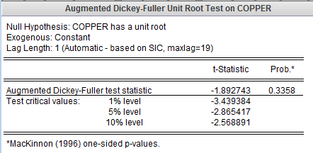
For Augmented Dickey-Fuller test
The test’s null hypothesis is that Copper has a unit root/not stationary. It cannot be rejected as the p-value > 0.05 and indicates that the series is not stationary. (can include a constant and trend)

Slide 4
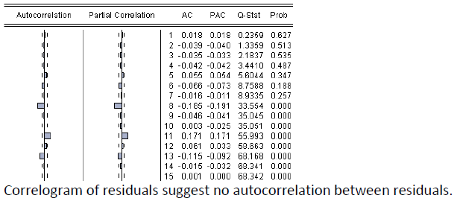

Slide 5
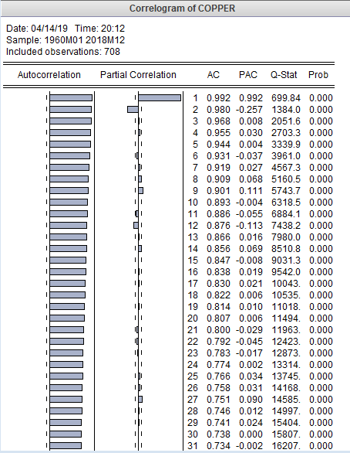
From the augmented Dickey-Fuller test, the series doesn’t look stationary.
Because neither Autocorrelation nor Partial Correlation doesn’t goes to 0 fast.

Slide 6
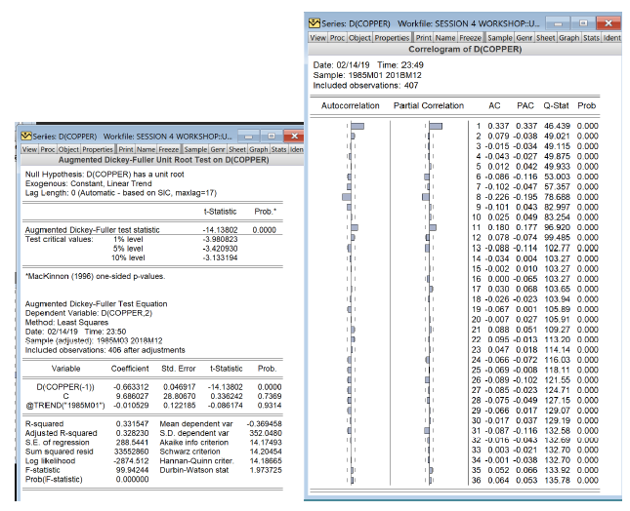
the unit root tests give me probability close to 0 for t-statistics. And the correlogram of the D(copper) plot is random and close to 0 for ACF and PACF, therefore it is stationary
The autocorrelation function are not persistent which suggests stationary

Slide 7
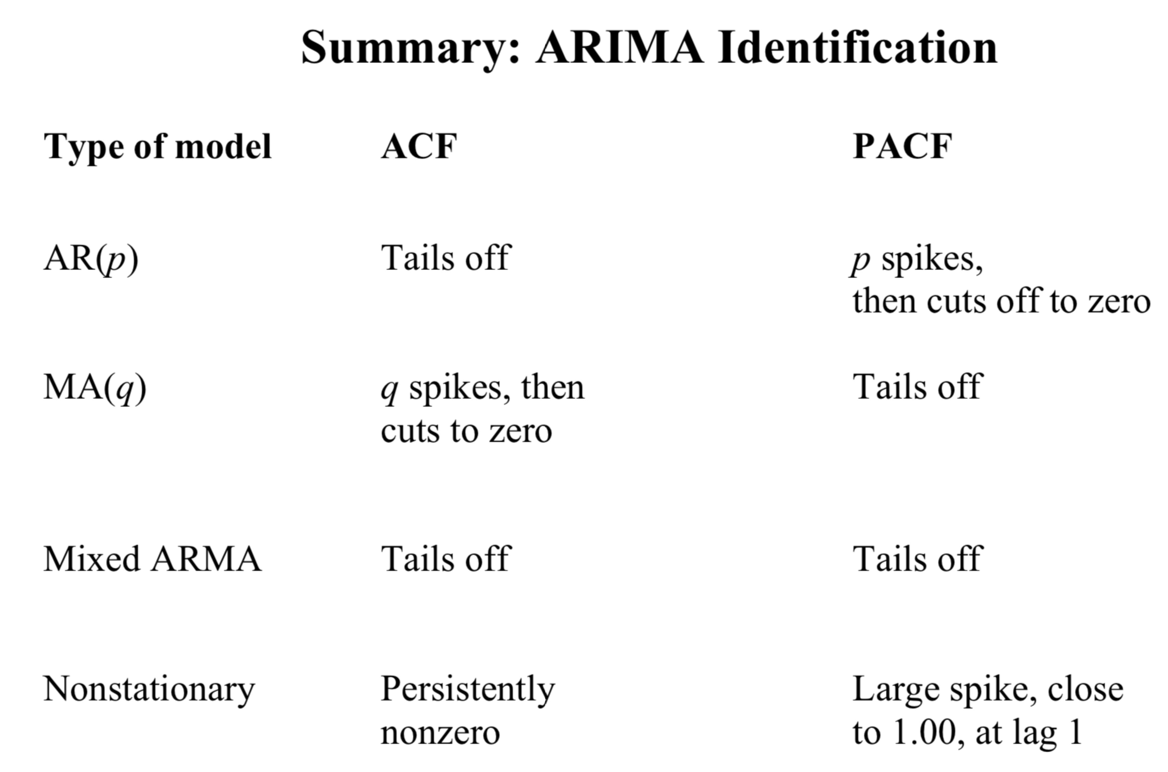
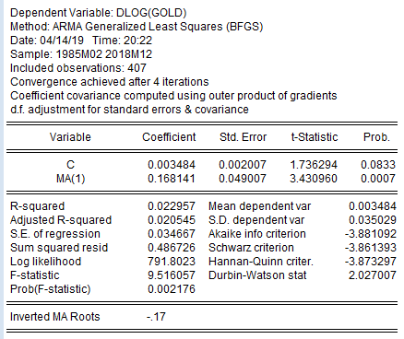

Slide 8
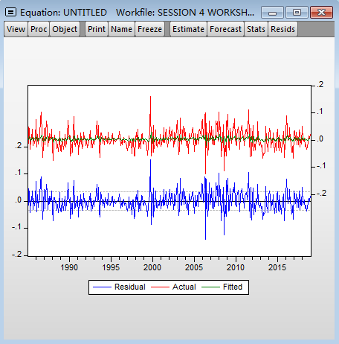
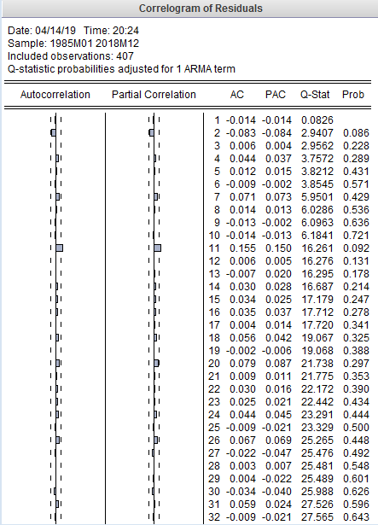
Furthermore, none of the Q-Statistic is smaller than 5%, therefore none of the lag term is significant.
We have a stationary residual

Slide 9
We will now compare the following four models with MA(1), and see which gives the smallest RSS, SBC, AIC, and HQ
From the table comparison below, MA(1) is very good model with smallest SBC, smallest HQ, and due to principal of parsimony, it’s a very simple model and is really preferred.
Besides MA(1), ARMA(2,0) is the best out of the four models listed. It gives the smallest AIC, biggest Adjusted R-Square, no Q-Stats significance and have constant coefficient non-significant, and both AR(1), AR(2) coefficient significant.

Slide 10
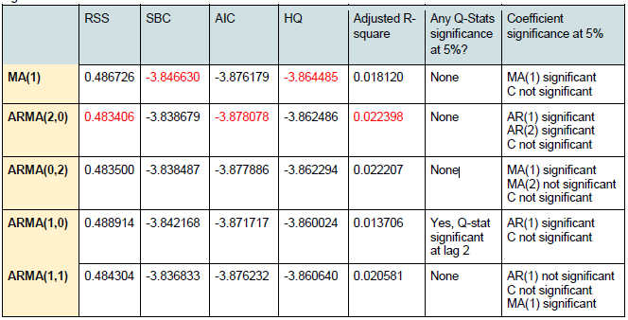
Model selection

Slide 11
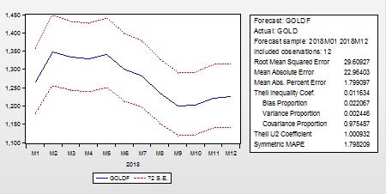
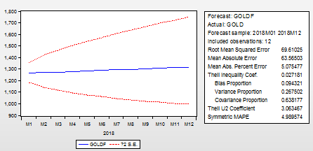
Static dlog(gold) c ma(1)
Dynamic dlog(gold) c ma(1)
Theil Inequality Coefficient: 3.4% indicates a very good fit.
Bias Proportion: 5%
the forecast for the mean are very close to the actual values.
Variance Proportion: 0.3%
the variance of the forecasts is almost perfect! This is due to modelling seasonal behavior.
Covariance Proportion: 94.6%
a big proportion of forecasting errors are unsystematic.

Slide 12
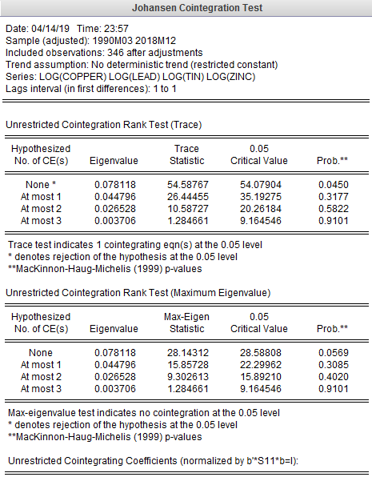
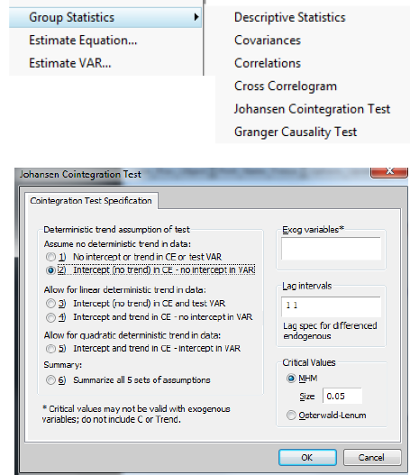
VAR & COINTEGRATION: Precious Metals
Conclusion: There is at most one cointegrating equation in the system of four metal prices
The trace rank test suggest that there is only 1
co-integration equation at 5% level as the
hypothesis that there is at most 1 cointeegration
equations cannot be rejected.
The Maximum Eigenvalue rank test suggest that
there is no cointegration at the 5% level as the
hypothesis of there is none cointegration cannot
be rejected.

Slide 13
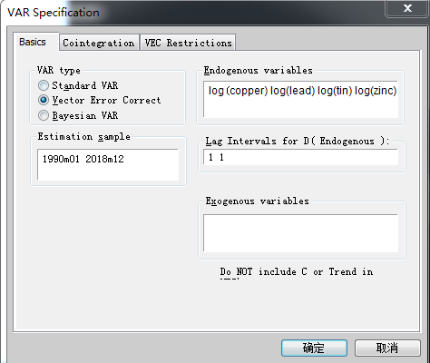
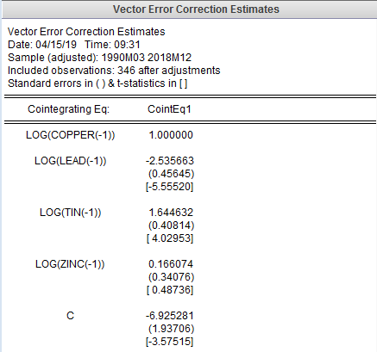
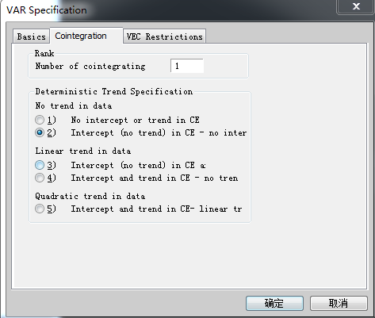
We got the following cointegration equation (as zinc is not significant):
log 𝑐𝑜𝑝𝑝𝑒𝑟 −1 = 2.53log (𝑙𝑒𝑎𝑑 −1 ) − 1.64log (𝑡𝑖𝑛 −1 ) + 6.92

Slide 14
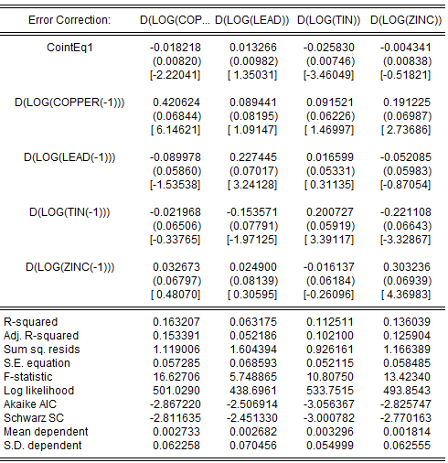
Copper price has significant effect on copper price and zinc price. Copper price is only affected by copper.
Lead price has significant effect on lead price only. Lead price is only affected by lead.
Tin price has significant effect on lead, tin and zinc price. Tin price is only affected by tin.
Zinc price has significant effect on zinc price only. Zinc price is affected by copper, lead and zinc.
Tin is the main driver, cause it affect lead , tin and zinc prices
How to improve model : remove zinc from the model

Slide 15
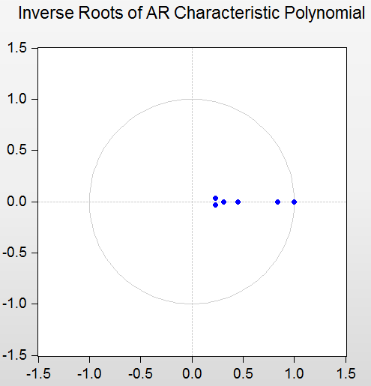
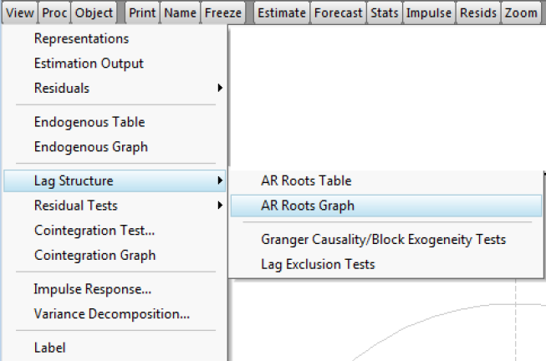
You finally need to analyse the stability conditions to test if any of the parameters or relationship between them is explosive.
All points are inside the circle so the result is safe and not explosive.

Slide 16
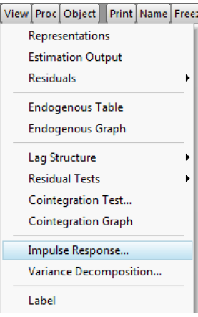
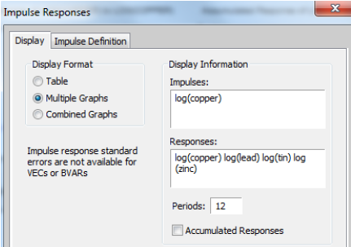
You can test the impact of an “innovation” or “shock” in one of the prices on the long-term impact of the other prices.
This is achieved by analysing the Impulse Responses。For example. This is the impulse response for an innovation on the copper price.

Slide 17
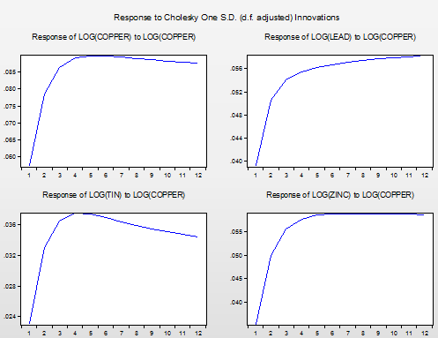
A. Log(Copper) response to increase in Log (Copper) is prominent during the first three months and quickly quiet off. Copper price increases significantly at beginning. Then it reversed the impact slightly toward the end of 12 months. It starts to drop due to the fact that when impact of copper price has realize on other metal prices, through system of equation, those changes also impact copper price back in the long term. Coefficients of lead and tin price change are negative on copper price change, that explains the reversion.
B. Log(Lead) response to increase in Log(Copper) demonstrates a strong impact in the first few months as can be seen by the fast increase in Log(Lead). The impact fades out but still shows an increase in the later periods.
C. Log(Tin) response to increase in Log(Copper) follows the same pattern as for Lead and Copper price. But after 4th month, after the impact has peaked, it shows a observable trend of decrease in tin price, reverses some of the impact caused previously.
D. Log(Zinc) response to increase in Log(Copper) also follows the same trend for the first 4 period, but the impact stays the same after it has reached its peak. Zinc price is highly influenced and to a certain degree determined by copper price.
E. In general, the impact of metal price changes are significant over the first 3 month and gradually fade off. It also conforms to the positive coefficients of D(LOG(COPPER) to all other 3 DLOG in the system of equation above.

Slide 18
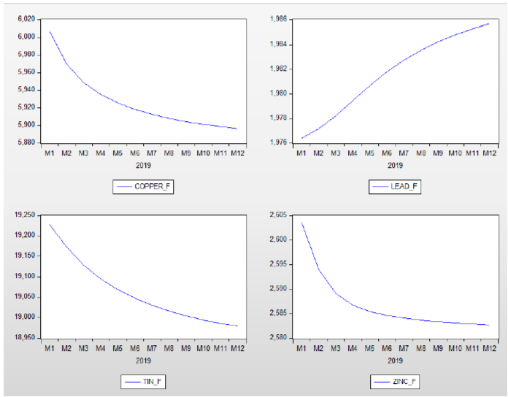
Finally, you can test the model’s forecasts. In the next figure you find the out-of-sample forecasts for 2019.
Following from conclusion earlier, tin price is the main driver in this system. Tin price is predicted to go down and from the negative coefficients of its impact on lead price, lead price should change inversely. This explains why predicted lead price goes up. As for copper, as indicated by the equation in part 3, in the long-term, its price is negatively correlated with lead price and positively correlated by tin price, with the decreased predicted tin price and increasing lead price, copper price is predicted to go down. Zinc price is influenced by its own price and copper price. The positive coefficient of DLOG(Copper(-1)) to DLOG(ZINC(-1)) drives the downward trend in predicted zinc price.

Slide 19
a) Equation Analysis
Stochastic Programming
stateValue(s0,normal,s1)..
v(s0,normal) - 0.796*v(s1,normal)
- 0.0995*v(s1,disrupted) - 0.0995*v(s1,very_disrupted) =G= -4002 ;
Explanation:
If The initial state was normal and the next state is s1, it means a purchase of 100 is being made, which will lead to outgo of 4000(100*40$) + 2(100*.002$)

Slide 20
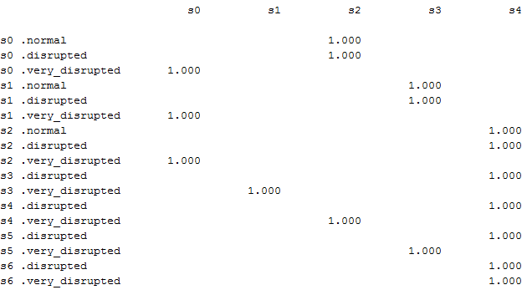
Optimal Policy
Normal Scenario:
From S0 to S8 the best option is to buy 200 kbbl every month
Disrupted Scenario:
From S0 to S2 the best option is to buy 200kbl as inventory is very low. From S3 to S7 the best option is to retain the inventory as the inventory s moderate. From s7 to S10 the best option is to sell 200 Kbbl as the inventory is very high
Very Disrupted Scenario:
From S0 to S2, no action can be taken. From s3 to s10, the best option is to sell the 200kbbl as the selling price is high and the inventory is also high

Slide 21
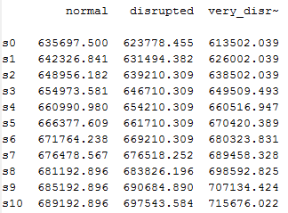
Expected Profit
The mimimum profit will be 613502. while the maximum profit will be 715676.

Slide 22
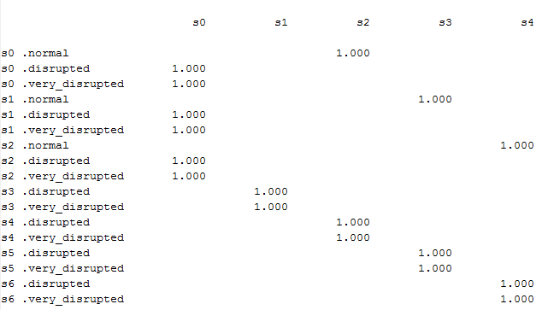
Optimal Policy – Discount factor -90%
Normal Scenario:
From S0 to S4 the best option is to buy 200 kbbl every month. Since the discount is very high the future value is low that the returns are very low from s5 to s8 it doesn’t make sense to keep high inventory

Slide 23
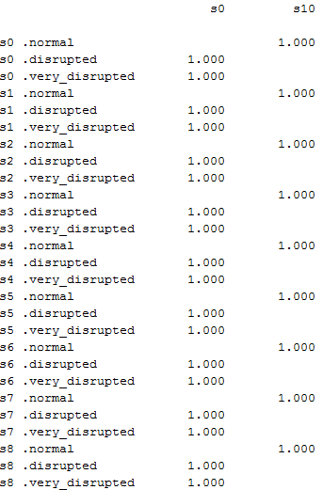
Optimal Policy – No Trading Restriction
Normal Scenario:
Since there are no trading restriction, buy maximum whenever its is normal
Disrupted Scenario & Very Disrupted:
Whenever price is high, sell maximum and book the profit

Slide 24
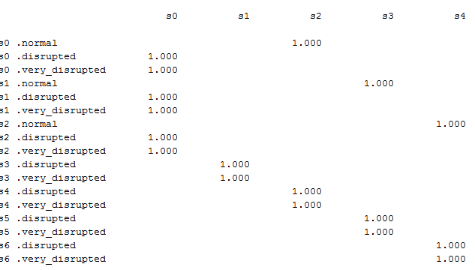
Optimal Policy – New Transition Matrix
the restriction on the maximum trading per month is the most important because it limits the max trading restriction which limits the profit
Normal Scenario:
From S0 to S10 the best option is to buy 200 kbbl every month since the probability of normal is very high
Disrupted Scenario & Very Disrupted Scenario:
From S0 to S10 sell the maximum that can be sold as the probability of normal price is very high

Slide 25
What is the different between the risk-averse and the risk-neutral optimal policies?
Risk neutral optimal policy only focuses on expected return. Risk averse policy seeks to decrease probability of a loss. The risk averse policy therefore focuses on a fixed probability of loss (β). By fixing β, the portfolio can be varied.
What is the impact of the target on the monthly return on the V@R and on the optimal policy?
Decreasing target annual return will result in lower expected monthly return but also reduced risk (VAR). This is achieved through diversifying the portfolio. Increasing the target annual return results in higher expected monthly return but also increased risk (VAR). This results in focusing the entire portfolio in the single highest return stock (AAPL).
If we are to increase the target return to 1%, we would put all our funds to just APPL that gives the highest return. If we are to decrease the target return to 0.1%, we would put our funds across all other 4 stocks (MCD, QQQ, SPY, TLT) except APPL

Slide 26
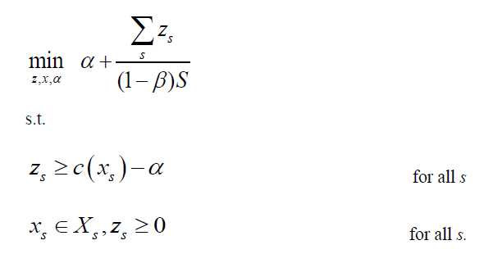
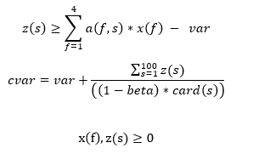
For CVAR
tails(s).. z(s)=g=-sum(i,a(i,s)*x(i))-var;(for profit will be –sum, for cost will be sum)
cvar_eq.. cvar =e= var+1/((1-beta)*card(s))*sum(s,z(s));
Minimizing CVAR

Slide 27
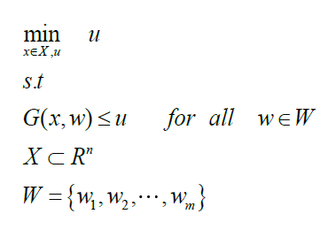
For worst case
tails(s).. mu=g=-sum(i,a(i,s)*x(i));
Minimizing mu

Slide 28
What is the optimal policy for beta of 0.9, 0.95 and 0.99?
What is the CV@R, V@R, and expect return of the optimal policies
As beta increases, the portfolio reduces AAPL stock and increase proportion of SPY. The portfolio expected monthly return remains stable but the CVAR increases
How does the number of scenarios influence the previous solution?
CVAR is very sensitive is to the number of scenarios: If we use more scenarios the results will be more consistent and it will give us a meaningful read between betas. But if we have very few scenarios the results less consistent. Expected values will not be impacted materially by the number of scenarios.

Slide 29
 |  | Risk Nuetral | CVAR | CVAR | CVAR | CVAR | Worst Case
Scenario |  | 1000 | 1000 | 1000 | 1000 | 1000 | 1000
Beta |  |  | 0.9 | 0.95 | 0.99 | 0.999
Mix
 | Apple | 24.20% | 15.30% | 15.50% | 9.40% | 5.30% | 5.30%
 | Lemon | 24.60% | 21.00% | 21.10% | 18.60% | 16.90% | 16.90%
 | Grape | 25.50% | 32.20% | 32.10% | 36.70% | 39.80% | 39.80%
 | Orange | 25.70% | 31.50% | 31.40% | 35.40% | 38.10% | 38.10%
Cost |  | 0.998 | 0.974 | 0.974 | 0.980 | 0.985 | 0.985
V@R |  |  | 1.772 | 1.919 | 2.265 | 2.900
CV@R |  |  | 1.999 | 2.158 | 2.482 | 2.900
Mu |  |  |  |  |  |  | 2.900

Slide 30
Risk neutral case: 100% of feeds will be barley since it is cheapest. The average cost is lowest is the lowest but not always guaranteed.
The worst-case scenario and CV@R when the beta is 0.999 (for 1,000 scenarios) or 0.9999 (for 10,000 scenarios) have the same optimal policy, which is expected, since with high beta, the worst scenario was captured in the result.
Using CV@R analysis: Feeds proportion is varied among the four feeds. The higher the Beta, the higher the CV@R. Even though the barley is cheapest, but its price fluctuates more than oat’s price (larger price standard deviation).
However, if taken into account of the requirement for protein and fat, oat has the lowest protein among the four feeds, while grnd-meal has the highest protein per unit. Therefore, grnd-meal will be more value-for-money in terms of protein.
On the other hands, fat is also one of the requirements for the feeds. Sesame has the highest fat and also the best of value-for-money in terms of fat component.

Slide 31
Using Worst-Case analysis: Similar to using CV@R analysis, feeds proportion is varied among the four feeds as well.
There are differences in the results when using 1,000 or 10,000 scenarios.
When using 1,000 scenarios, the optimal policy for using CV@R analyses (for beta of 0.9, 0,95 and 0,99) and Worst-case scenario are significantly different. The higher the beta for CV@R, the least grnd-meal proportion in the optimal policy. Worst case optimal policy did not have grnd-meal in the list due to high mean price and high price fluctuation which is riskier.
However, when using 10,000 scenarios, the optimal policy using worst case scenarios and CV@R with different beta did not varied a lot. The optimal policy is to buy the most oat, then barley and follow by sesame and grnd-meal. The cost of the worst case is $64.64.

